Slide 1
Collaborative Recommendation Techniques
Ioannis Chamodrakas, Ph.D.
Prof. Ioannis Emiris

Slide 2
Problem Statement
U = {u₁,…,u_{i},…,u_{N}} a set of N users
I = {i₁,…,i_{j},…,i_{M}} a set of M items
R: U x I → R_{o}, a rating function
Usually R_{o} ⊆ N = {0,1,2,…}
Problem: Predict unknown R(u_{i},i_{j}) when values R(u_{k},i_{l}) known for many k∈{1,…,N}, l∈{1,…,M}.
Recommend best or few highest rated items (usually up to 5) for user u_{i .}
Technologies for Web Applications
2

Slide 3
Memory based approach
Derive ratings from similar users (or items) according to past ratings, e.g. some ΝNs according to some similarity function.
In practice, neighborhood size P∈{20-50}.
R(u,i) = z * Σsim(u,υ)*R(υ,i)
or, rather:
R(u,i)=R(u)+z*Σsim(u,υ)*(R(υ,i)-R(υ))
υ ∈ Neighborhood(u), z=normalizing factor
(e.g. 1 / Σ|sim(u,υ)|), R(u) average rating of user u.
Technologies for Web Applications
3

Slide 4
Memory based: similarity
A good similarity function is Cosine similarity:
sim(u,v) = u ⋅ v / ( ||u|| ⋅ ||v|| )
Every user represented by a vector in M-dim space of items, with item ratings as coordinates.
Non-rated items usually treated as zero.
Issue: lack of rating more similar to disliking than liking item.
Other approaches: Rounding, or assign to unrated items a constant, adjusted experimentally to minimize error.
Our approach: Normalization (next slide).
Technologies for Web Applications
4

Slide 5
Memory based: unrated
Two ways to treat unrated items
Normalization:
R’(u,i) = R(u,i) – R(u), R(u) = average rating of u.
Rounding (cutoff):
E.g. R_{o}={1,2,3,4,5}: R’(u,i)=0 if R(u,i)<=2, R’(u,i)=1 if R(u,i)>2.
Geometric Data Analysis
5

Slide 6
Model based and other approaches
models users based on their past ratings, then uses models to predict unknown ratings.
k-Means clustering
Latent semantic models
Matrix Factorization
Bayesian clustering
probabilistic Latent Semantic Analysis
Diffusion-based methods
Heat Spreading
Technologies for Web Applications
6

Slide 7
Recommendation Algorithms
NN (by Cosine LSH):
Find P neighbors with Cosine LSH (slides 1.nnLSH), 20≤P≤50.
Calculate R(u,i) from ratings of P closest users.
Recommend 5 top-rated items.
k-Clustering: 1. Cluster the users: optimize k through Silhouette. 2. Calculate R(u,i) from ratings of users in same cluster
3. Recommend 5 top-rated items.
Technologies for Web Applications
7

Slide 8
Matrix Factorization
Matrix Factorization methods belong to the Latent Semantic Models category.
Rating function R is used to construct a M x N rating matrix X (x_{ij} stores the rating of the jth item provided by the ith user).
The set of all known (i,j) pairs in X is denoted as S
The idea behind MF is to approximate the matrix X as to product of two matrices:
X ≈ VF, where V is a M x K and F is a K x N matrix; K is the number of latent features.
v_{ik} can be considered as the value of kth latent feature of ith user and f_{kj} as the value of kth latent feature of jth item

Slide 9
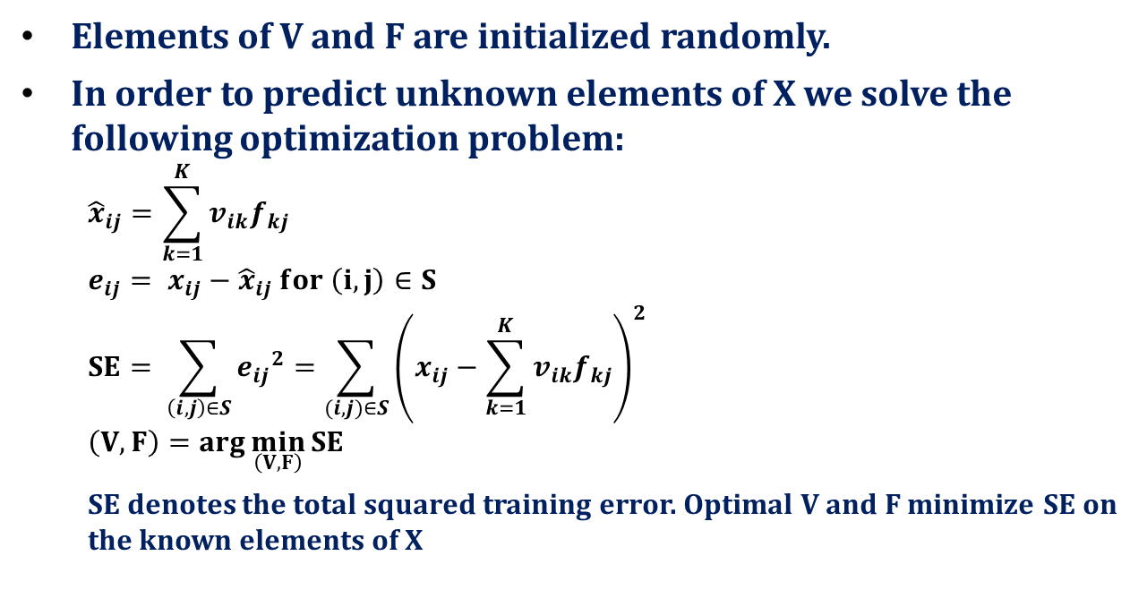
Matrix Factorization: Optimization
Elements of V and F are initialized randomly.
In order to predict unknown elements of X we solve the following optimization problem:
$${\hat{x}}_{ij}=\sum_{k=1}^{K}{v_{ik}f_{kj}}$$
$$e_{ij}= x_{ij}−{\hat{x}}_{ij} for \left(i,j\right)∈S$$
$$SE= \sum_{\left(i,j\right)∈S}{{e_{ij}}^{2}=\sum_{(i,j)∈S}{{\left(x_{ij}−\sum_{k=1}^{K}{v_{ik}f_{kj}}\right)}^{2}}}$$
$$\left(V,F\right)=arg\min_{\left(V,F\right)}{SE}$$
SE denotes the total squared training error. Optimal V and F minimize SE on the known elements of X

Slide 10
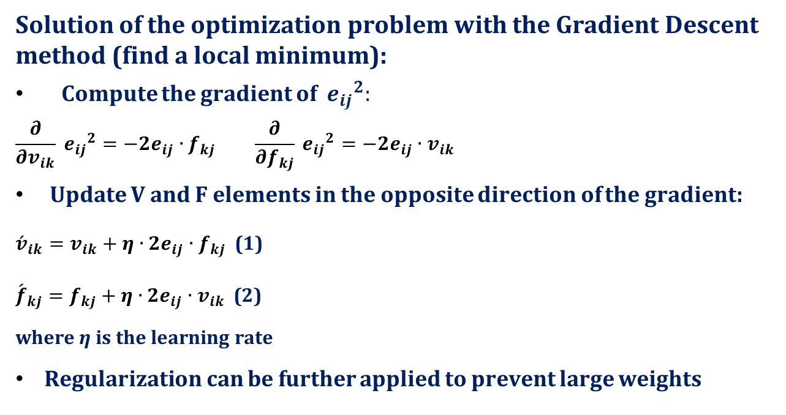
Matrix Factorization: Gradient Descent
Solution of the optimization problem with the Gradient Descent method (find a local minimum):
Compute the gradient of ${{ e}_{ij}}^{2}:$
$$\frac{∂}{∂v_{ik}}{{ e}_{ij}}^{2}=−2e_{ij}∙f_{kj} \frac{∂}{∂f_{kj}}{{ e}_{ij}}^{2}=−2e_{ij}∙v_{ik}$$
Update V and F elements in the opposite direction of the gradient:
${\acute{v}}_{ik}=v_{ik}+η∙2e_{ij}∙f_{kj}$ (1)
${\acute{f}}_{kj}=f_{kj}+η∙2e_{ij}∙v_{ik}$ (2)
where η is the learning rate
Regularization can be further applied to prevent large weights

Slide 11
Matrix Factorization: Algorithm
Initialize the elements in V and F randomly. Set η to some small positive value
Loop until the terminal condition is met
Iterate over each known element of X x_{ij}
compute e_{ij};
compute the gradient of e²_{ij};
update the ith row of V and the jth column of F according to equations (1) and (2)
Calculate the RMSE
Terminate the loop when the RMSE does not decrease during two iterations
Calculate X_{predicted} = VF and predict unknown ratings
Return 5 top rated unknown items per user i

Slide 12
Matrix Factorization: Algorithm Parameters and fine tuning
The number of latent features: K
Different learning rate η for users and items, at different learning cycles, for different features
Probability distribution to initialize V and F
Normalize X before learning

Slide 13
Heat Spreading: Definitions
U: set of N users
I: set of M items
A_{MxN}: the rating matrix
A_{αi}= 1, if item α is collected by user i (e.g. visited link / item rating over a threshold)
A_{αi}= 0, otherwise
k_{α} the number of users who have collected item α
k_{i} the number of items collected by user i
f_{i} the i-th column of matrix A

Slide 14
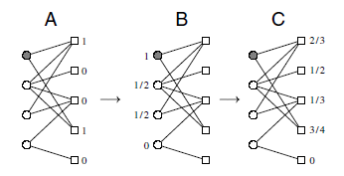
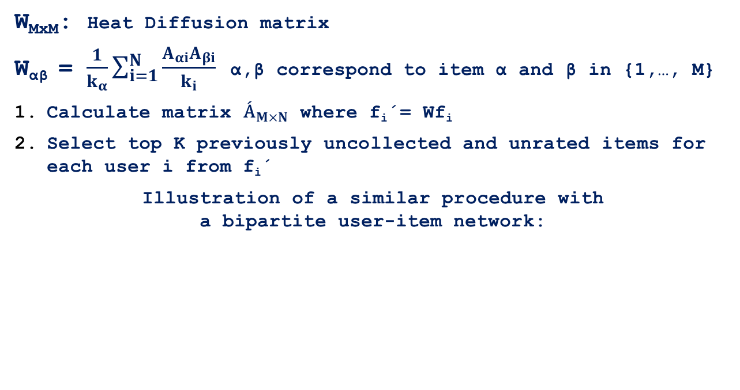
Heat Spreading: Algorithm
W_{MxM}: Heat Diffusion matrix
W_{αβ} = $\frac{1}{k_{α}}\sum_{i=1}^{N}{\frac{Α_{αi}A_{βi}}{k_{i}}}$ α,β correspond to item α and β in {1,…, M}
Calculate matrix ${\acute{\text{A}}}_{M×N}$ where f_{i}΄= Wf_{i}
Select top K previously uncollected and unrated items for each user i from f_{i}΄
Illustration of a similar procedure with a bipartite user-item network:

Slide 15
Algorithm Validation
Partition dataset into training (known input) and validation subsets
Predict ratings in validation subset and compare with true ratings.
Mean Absolute Error:
ΜΑΕ = (1/J) * Σ|R_{j}-P_{j}|, 1≤j≤J
J=#(item,user) pairs in validation subset i.e. ratings known & predicted: R_{j}=actual rating, P_{j}=predicted rating
Technologies for Web Applications
15

Slide 16
l-fold cross-Validation
l-fold cross-validation of the recommendation algorithms:
Split the rating dataset into l equal-size subsets randomly. E.g. uniformly pick J/l pairs, l –1 times; or pairs uniformly mapped in {1...l}.
Repeat l times (folds): each subset used exactly once for validation, the others used as training data to predict ratings; then calculate Mean Absolute Error (MAE).
Return average MAE (or other combination) from the folds.
[Wikipedia]
Technologies for Web Applications
16

